Slide 1
An introduction to the P-model
LEMONTREE experimental WG meeting
February 15, 2022

Slide 2
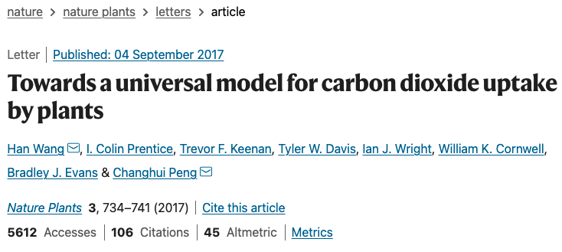

Slide 3
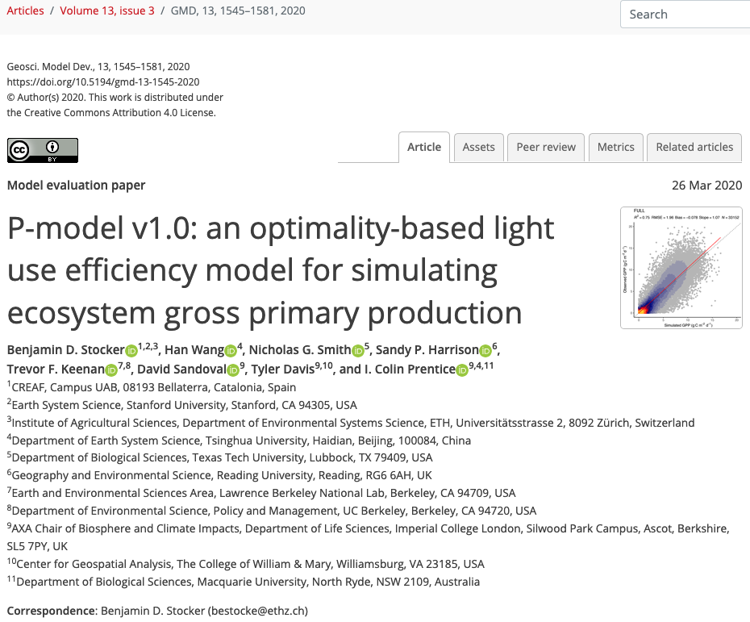

Slide 4
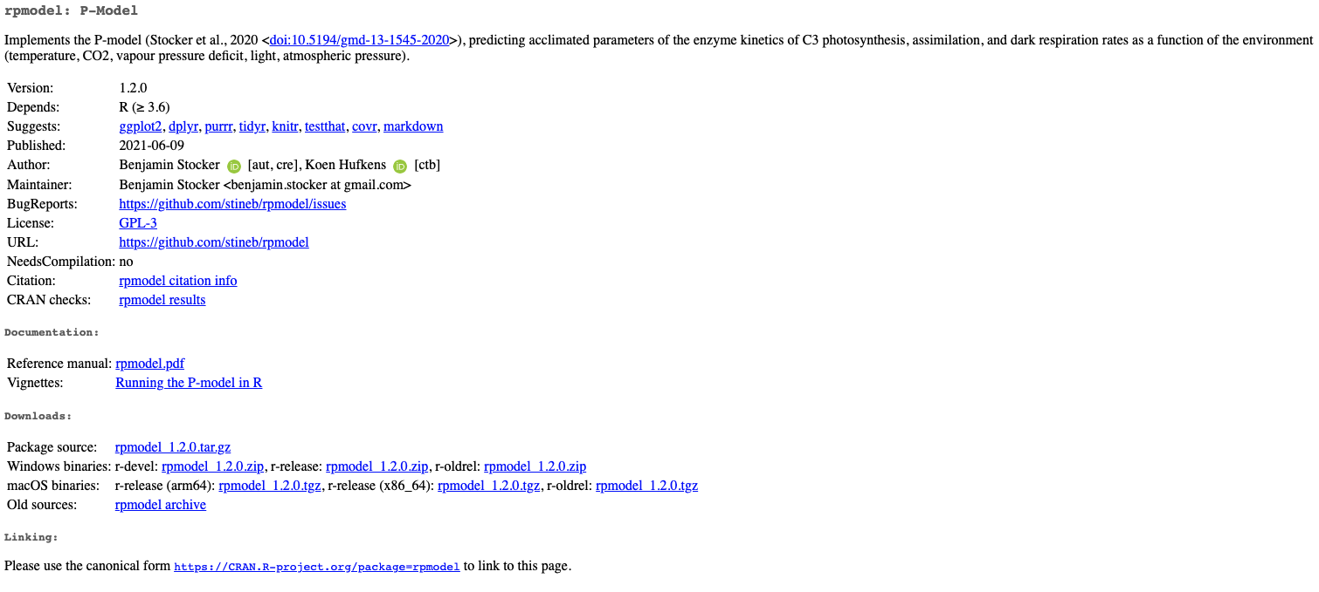

Slide 5
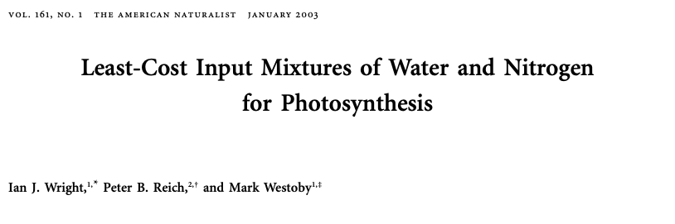
P-model basis: Least cost theory
Wright et al. (2003)

Slide 6
P-model basis: Least cost theory
Optimally, plants will maintain fastest rate of photosynthesis at the lowest summed resource cost (water and nutrient use)
Wright et al. (2003)

Slide 7
P-model photosynthesis
Photosynthesis = f{stomatal conductance,
photosynthetic biochemistry}

Slide 8
P-model photosynthesis
Photosynthesis = f{stomatal conductance,
photosynthetic biochemistry}
Must predict optimal rates of both

Slide 9
P-model photosynthesis
Photosynthesis = f{stomatal conductance,
photosynthetic biochemistry}
Prentice et al. (2014); Wang et al. (2017); Smith et al. (2019)

Slide 10
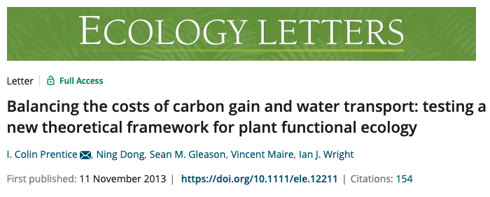

Slide 11
Open stomata:
Benefits
High CO₂ influx
Costs
High water outflux
Closed stomata:
Benefits
Low water outflux
Costs
Low CO₂ influx

Slide 12
Open stomata:
Benefits
High CO₂ influx
Costs
High water outflux
Closed stomata:
Benefits
Low water outflux
Costs
Low CO₂ influx
Must maintain high amount of Rubisco to do photosynthesis

Slide 13
P-model stomatal conductance
Optimal conductance maximizes photosynthesis at least water loss and nutrient use
Water loss is from transpiration
Nutrient use is nutrients used to maintain Rubisco

Slide 14
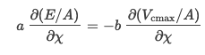
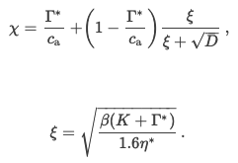
P-model stomatal conductance
a = cost to maintain transpiration
b = cost to maintain photosynthetic capacity
β = b/a
ξ = “squiggle”

Slide 15
Stomatal conductance trait The ratio of CO₂ in the leaf to CO₂ outside of the leaf (C_{i}/C_{a} or χ)

Slide 16
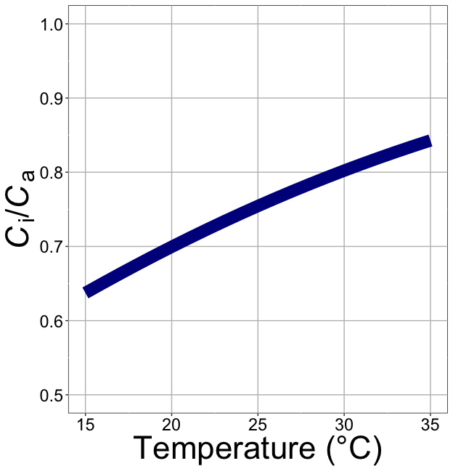
C_{i}/C_{a} increases with temperature because of greater photorespiration

Slide 17
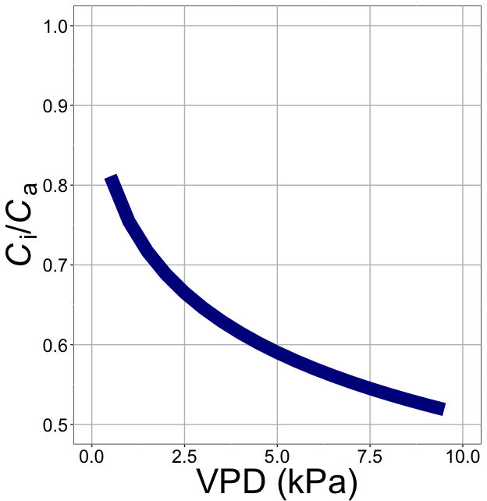
C_{i}/C_{a} decreases with VPD to avoid water loss

Slide 18
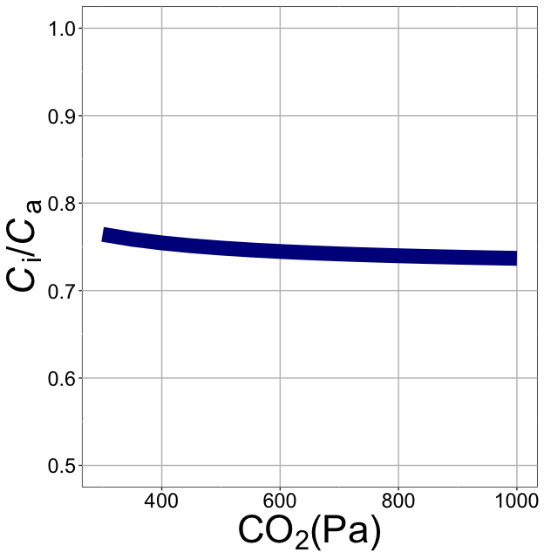
C_{i}/C_{a} decreases with CO₂ because of lower openness needed to satisfy Rubisco

Slide 19
P-model photosynthesis
Photosynthesis = f{stomatal conductance,
photosynthetic biochemistry}

Slide 21
P-model biochemistry
Plant biochemistry setup will aim for equal limitation by all factors

Slide 22
P-model biochemistry
A= min{Ac, Aj}
Ac = Vcmax(ci-Γ*)(1/(ci + K))
Aj=φI(ci-Γ*)(1/(ci + 2Γ*))
Optimally: Ac=Aj
Can use this to solve for traits:
Vcmax = φI(ci + 2Γ*) (1/(ci + K))
A = gross photosynthesis
Ac = carboxylation-limited photosynthesis
Aj = electron transport-limited photosynthesis
Vcmax = max carboxylation rate
ci= intercellular CO2
Γ* = CO2 compensation point
K = M-M coefficient (T dependent)
φ = quantum efficiency
I = absorbed PAR
*Note that there are more complex representations of Aj

Slide 23
Biochemistry trait The maximum rate of Rubisco carboxylation (V_{cmax})

Slide 24
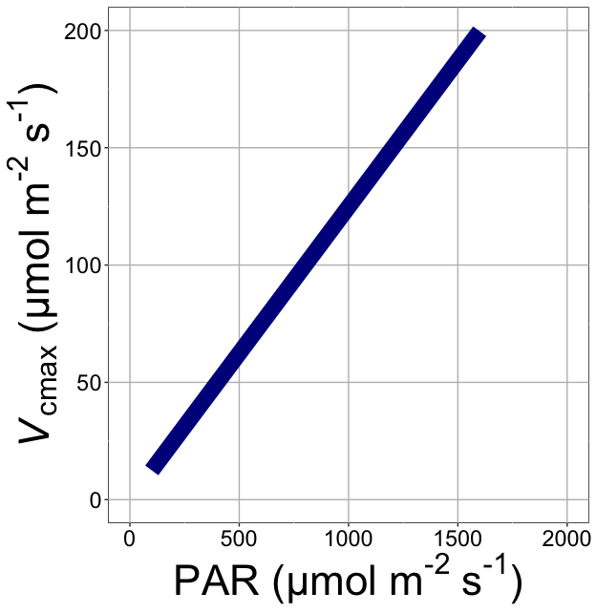
V_{cmax} increases with light because of greater electron transport

Slide 25
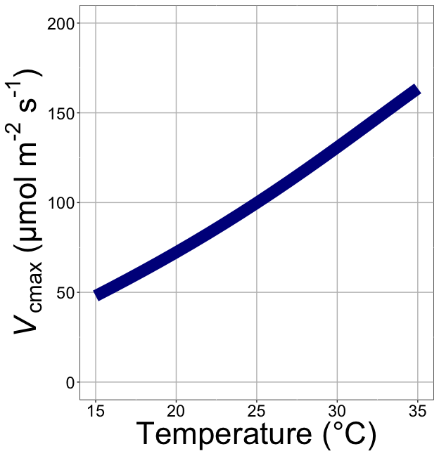
V_{cmax} increases with temperature because of greater electron transport and photorespiration

Slide 26
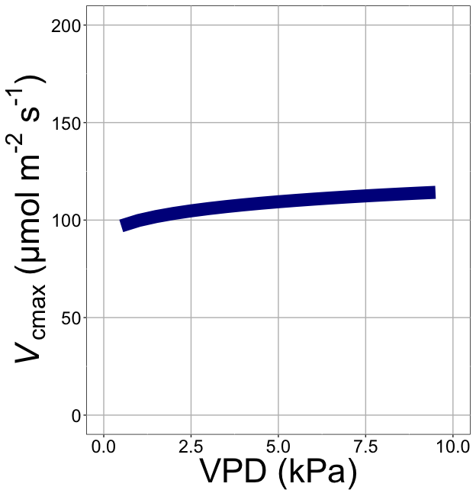
V_{cmax} increases with VPD because of lower stomatal conductance

Slide 27
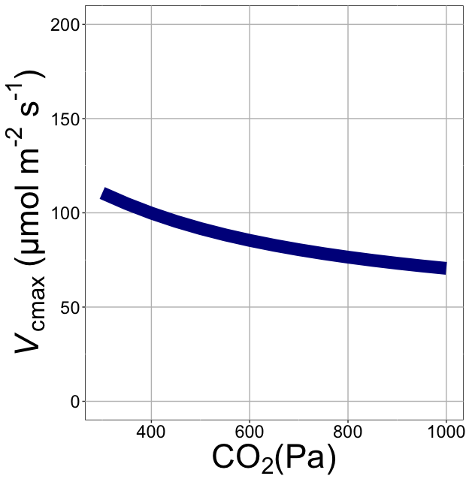
V_{cmax} decreases with CO₂ because of greater CO₂ in the leaf

Slide 28
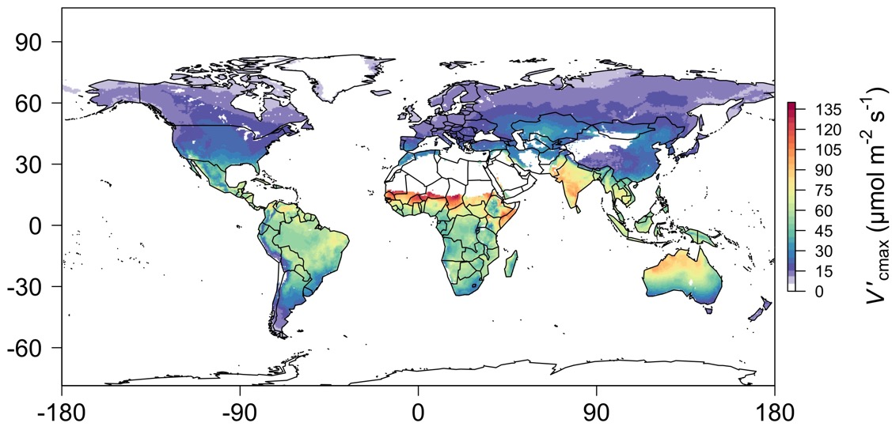
We can predict optimal traits in different environments
Smith et al. (2019)

Slide 29
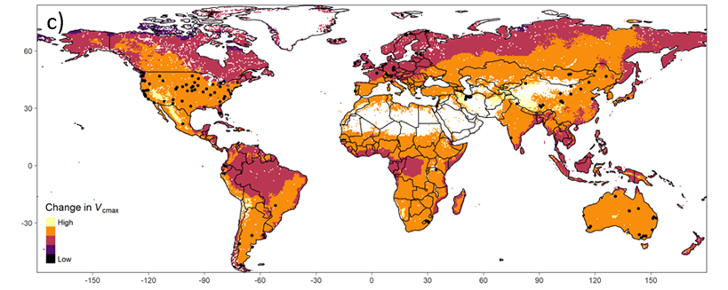
We can also predict responses to environmental change
Chieppa (unpublished)

Slide 30
Some things to note
β is static in the model, although we know costs for soil resource use vary (Paillassa et al., 2020)
Empirical soil water stress term (Stocker et al., 2020)
φ is an important, but unknown parameter
Currently a “wiggle” term
Timescale for acclimation is unknown
What aspect of variability plants acclimate to is unknown
Midday? (Mengoli et al. 2021)

